Slide 1
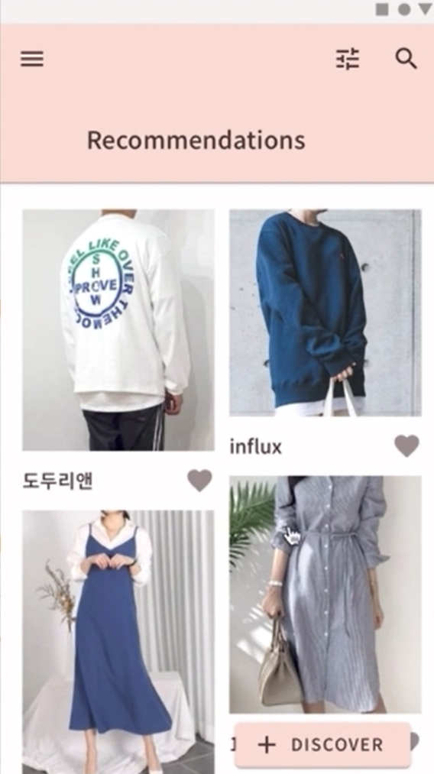
Flixtyle

Slide 2
index
01
04
Background
Plan
02
05
Project Objective
Expectations
03
06
Development
Reference

Slide 3
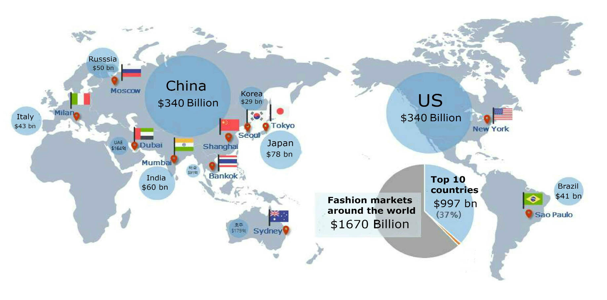
01
Background
Market value
The size of the fashion market around the world is increasing
Notes:
The size of the fashion market around the world is increasing. In a huge fashion market, consumer is exposed to the amount of information. Consumers want to choose a product that is easy, fast and accurate among them.

Slide 4





01
Background
Market value
However, their products are separated
Notes:
However, there is a limit to the systems that these companies offer. They only show their own product, or product in their own country. Their products are separated and each company does not share data from different companies.

Slide 5
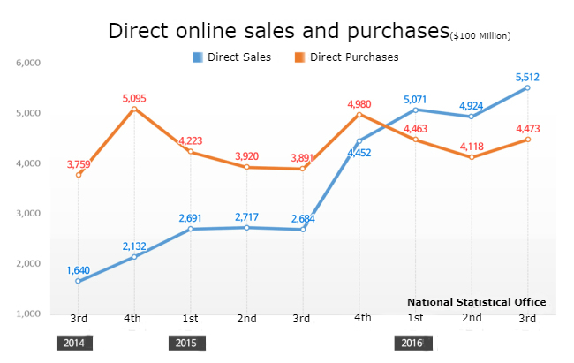
01
Background
Market value
02
03
Consumers are no longer limited to their country.
Notes:
But consumers are no longer limited to their country. It is now very common to use overseas shopping malls to find things that can't find in own country. In fact, the ratio of Direct purchase both from overseas in our country and reverse are increasing
In other words, today's consumers are not afraid to buy from another country.
Markets are no longer classified by 'country'. It's only classified by the ‘product type’

Slide 6

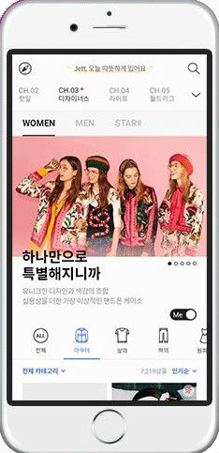
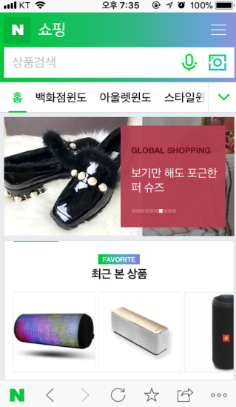
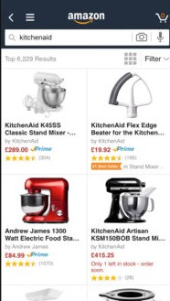
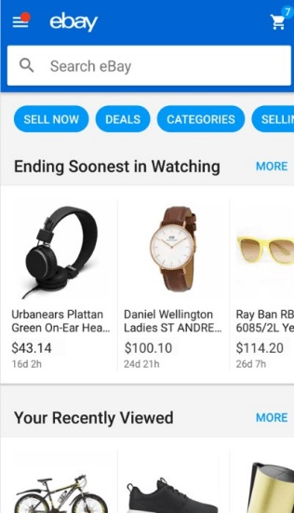
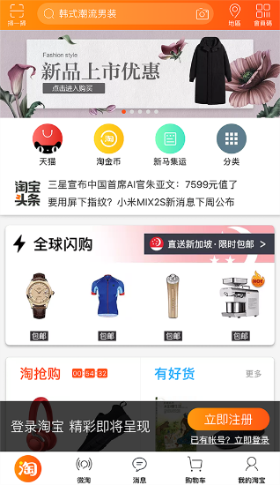
01
Background
Current system's problems
02
03
Where is the product that I want? And how can I find it?
Notes:
Then, where is the product that I want? Taobao? Amazon?
Or, if there's a dress in Naver shopping that goes well with the one I bought from eBay, how can I find it?

Slide 7
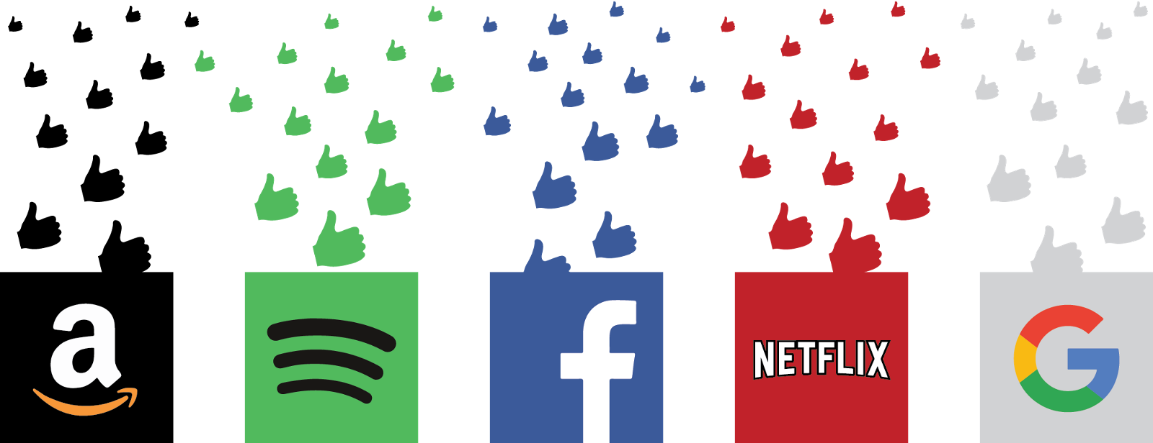




01
Background
Current system's problems
Companies provide recommendation systems to customers
Notes:
So, many companies have benefited to recommend products to their customers by recommendation system. The most representative examples are Amazon, Naver Shopping, Taobao, eBay and so on.

Slide 8
01
Background
Current system's problems
01
Criteria for evaluating the recommendation system
Novelty
02
Limited product and selection
Diversity
Recommend similar items to users
Confidence
Unreliable as the best choice
Convenience
Impossible to look around all the products
Notes:
The separation of this information also affects the functionality of the recommended system.

Slide 9







01
Background
Need for our system
01
02
03
Your style is just a Flick™ away
Notes:
Therefore, we will combine products from all over the world to show them on a single application and recommend the best of them.

Slide 10
02
Project Objective
Introducing Flixtyle
Flick
+
Style
Flick products based on your preference
Get recommendations based on your data
Simple
All you need to do is flick your finger left or right
When you want to buy a product, simply click
03
Smart
Our algorithms bring you tailored recommendations
Stimulating
Stimulate your mind with new styles
Think of new ways to mix and match
Notes:
Flixtyle is like a fashion tinder. For anyone who doesn’t know what tinder is, it is a dating app where you swipe left or right depending on if you like the person in the picture or not. Our app Flixtyle is going to be app where you can just flick your finger left or right depending on your preference of the clothing item. Left means that you like the item, and right means that you don’t.
By flicking products left or right, our app will give you recommendations based on your overall preference of style. The more data collected from the user, the better the recommendations will be. It’s very simple. Since all you need to do is flick a finger, it is basically an app anyone can simply use if they just have a phone. If one likes a product, they can go straight to the website that sells it and buy the product. Just a few simple touches and you’ll have the item you want.
The more you flick, the better recommendations you will get from our app. Our algorithms will bring users tailored recommendations which fit their interest. Sometimes, just the clothes in the recommendation section can be boring. Even though people usually go with a similar style, people interested in fashion want to try out something new. That’s why Flixtyle will have a separate recommendation section and have new styles for the user when swiping left or right.

Slide 11
02
Project Objective
Introducing Flixtyle
01
“customer loyalty depends on service quality (responsiveness and empathy) and usefulness, whereas in the mobile shopping, it only depends on enjoyment”
Koh, Joon, Choi, Su-Jeong, & An, Baicheng. (2015)
Notes:
The separation of this information also affects the functionality of the recommended system.

Slide 12
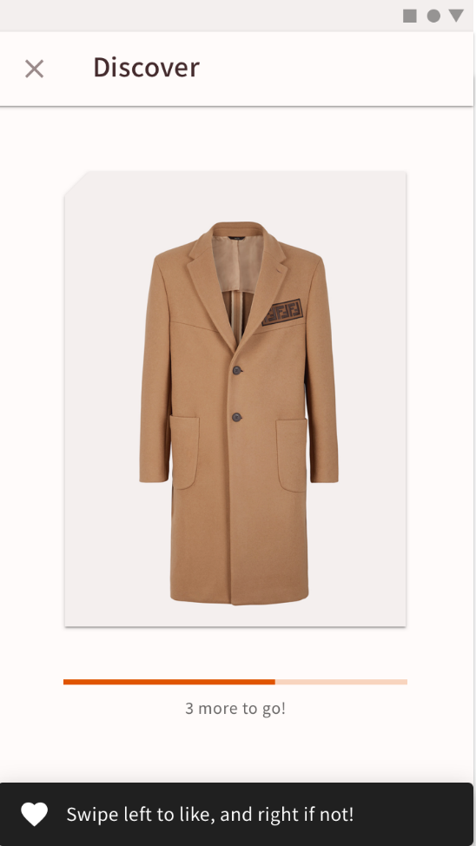
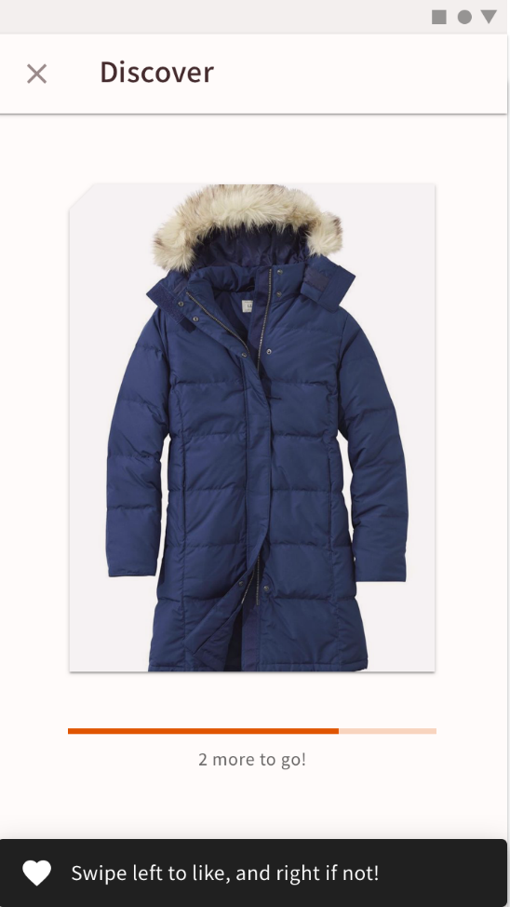
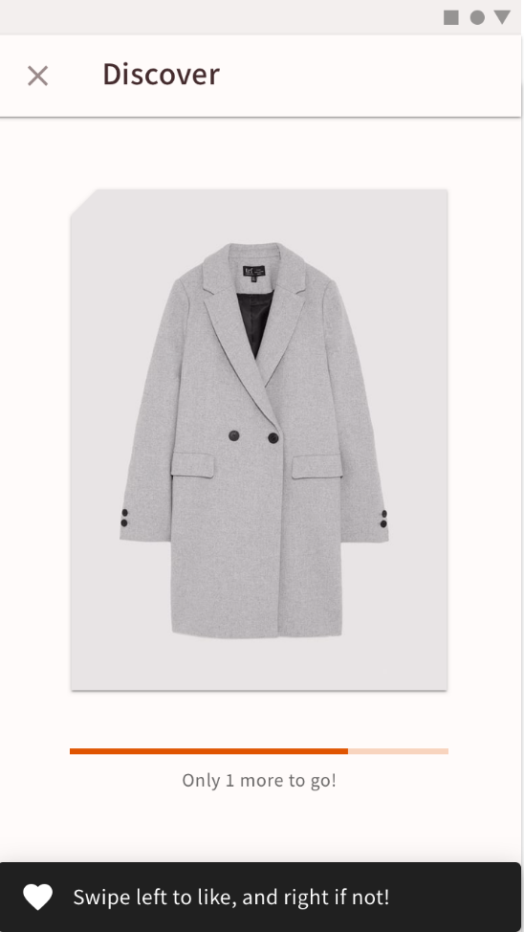
02
Project Objective
Prototype: Swipe left or right
Flick left or right based on your preference
02
03
Notes:
When you flick left, it means you like the item. When you flick right, it means you don’t! You will have to go through a set of clothes so that it can collect your data to give you recommendations.

Slide 13
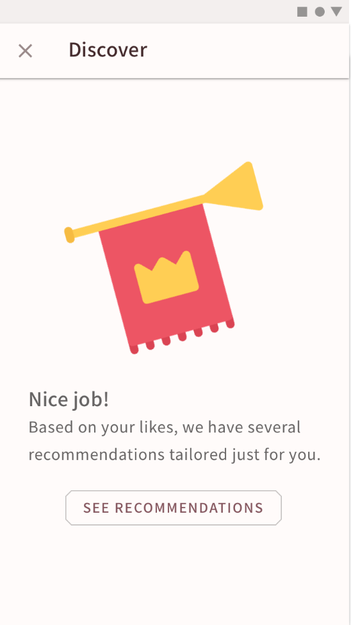
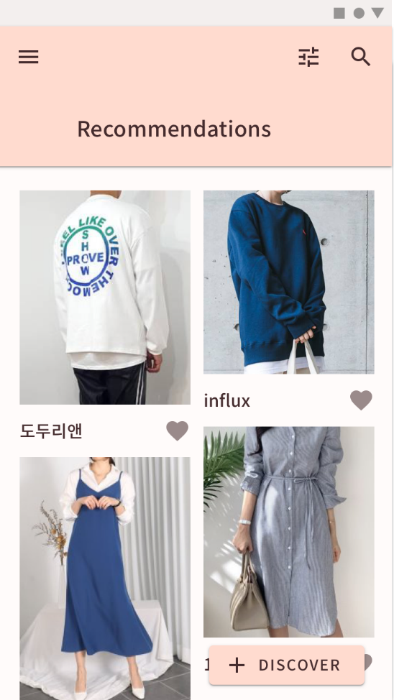
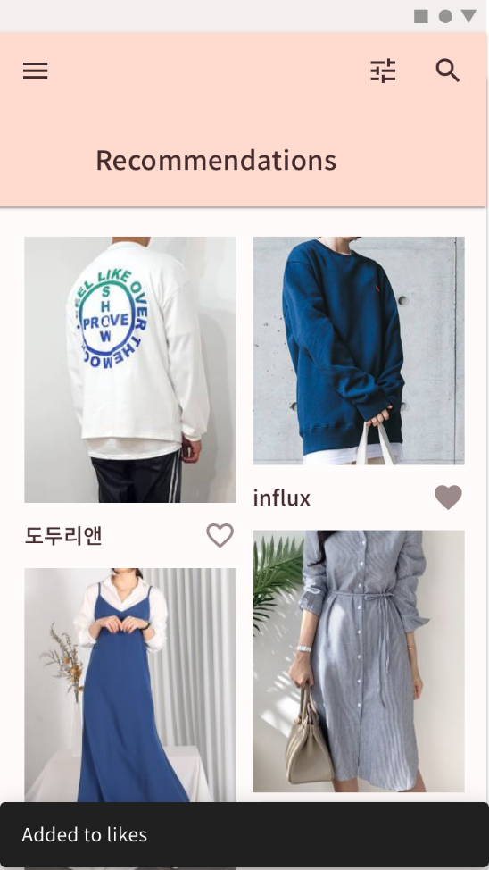
02
Project Objective
Prototype: Recommendations
Recommendations based on your swipes
Notes:
When finished with going through the set of clothes, the app will give you tailored recommendations based on your swipes. In the recommendations page, if you click the heart shape, the item will also shop up in the liked page.

Slide 14
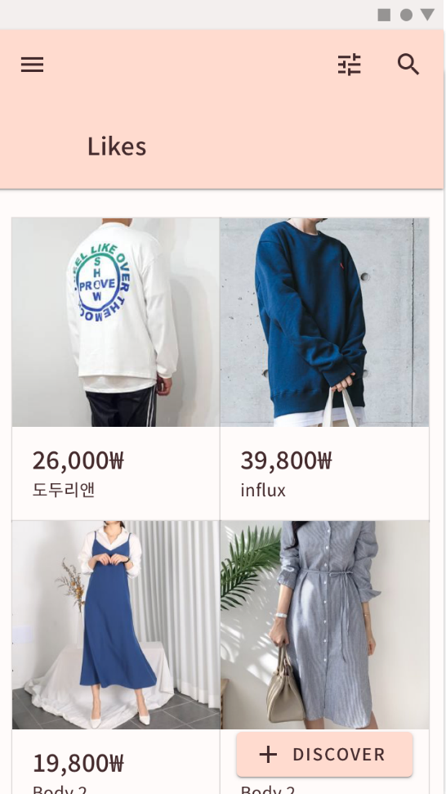
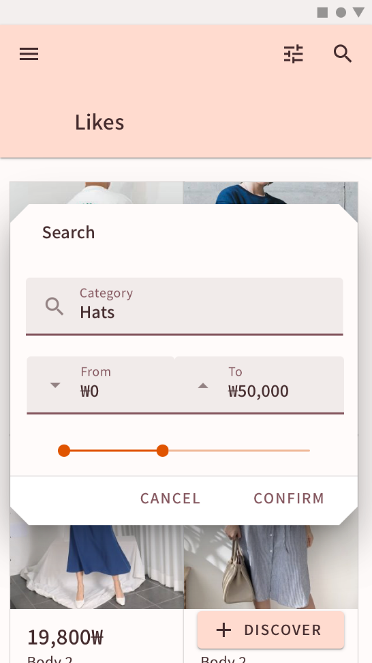
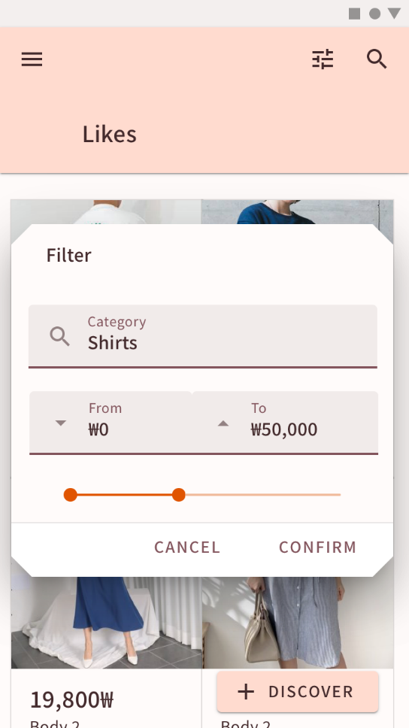
02
Project Objective
Prototype: Likes
View your likes Add filters to view specific things you want
Notes:
In the likes page, you can basically view everything you’ve liked. You can also add filters for the category, and price to view specific things you want.

Slide 15
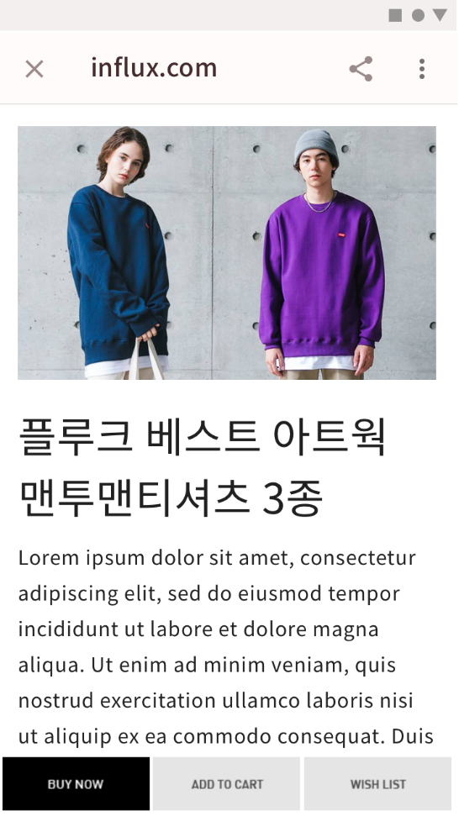
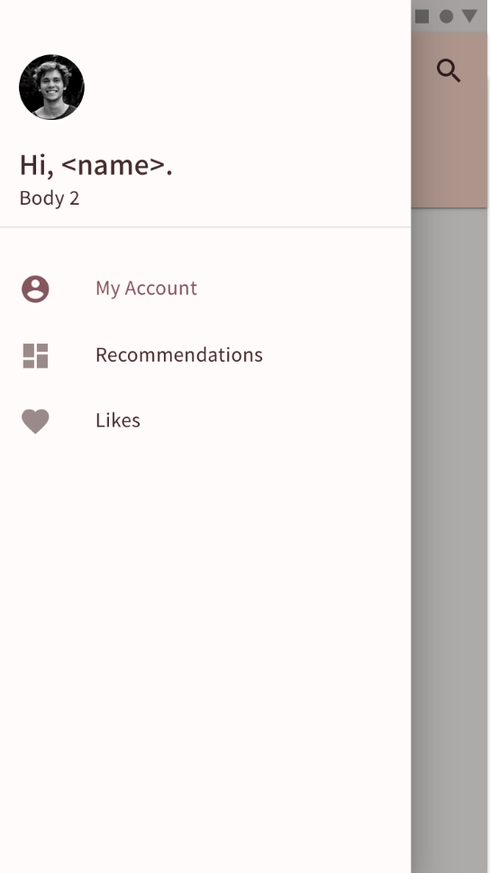
02
Project Objective
Prototype: Other
Click and move to the website selling the item
Menu
Notes:
When the user clicks on a product, they can move to the website that sells the item.
By using Flixtyle, you can save time looking for items that match your style. You can also look at products of many shopping malls at one time so there is little effort needed. You can also discover new styles that you never knew you were interested in.

Slide 16
03
Development
SCRUM with Pair Programming
Scrum Cycle
Pair Programming
Meetings are held once per week (every Friday)
Pairs will decide when to work together each week
Review the last sprint
Review work to be done on the next cycle
Plan the next sprint
Decide pairs for the cycle
Each pair shares their progress on Kakaotalk with the whole team
03
Expected to improve collective ownership
Maximize collaboration
Maximize participation

Slide 17

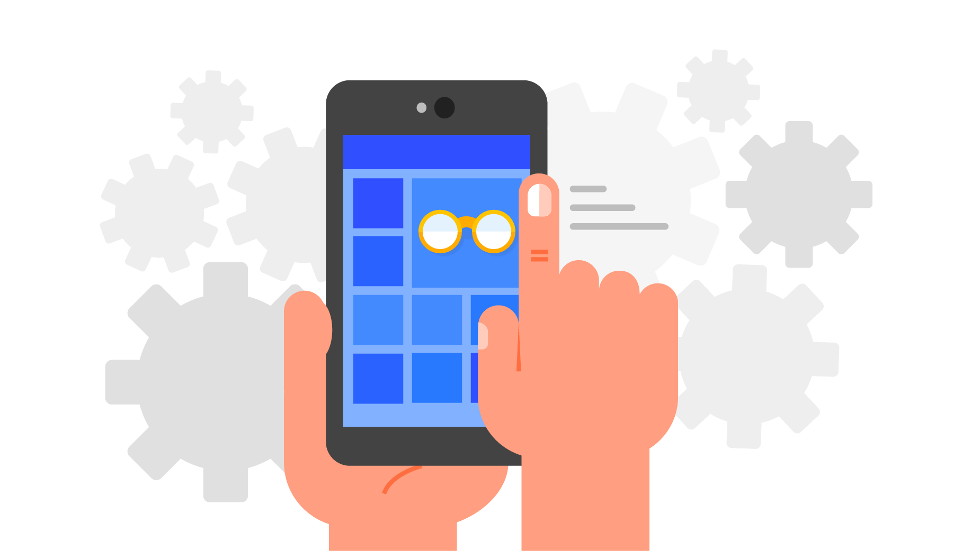
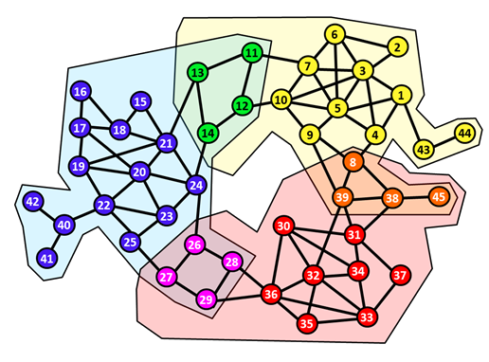
03
Development
Technology
01
PWA
(Progressive Web Apps)
RESTful API
Big Data Analysis
Notes:
Reference : https://developers.google.com/web/progressive-web-apps/
Reference : http://bigdata.ices.utexas.edu/project/graph-clustering/

Slide 18

03
Development
Technology
PWA (Progressive Web Apps)
Can be added to the user's home screen like apps
Accessible from various platforms
RESTful API
Virtually the norm for online APIs
Lightweight & works well with web sites

Slide 19
03
Development
Technology
Big Data Analysis
(Overlapping Community Detection)
Each product is shown as a node
Edges connect nodes which are liked by the same person
A non-directed graph is formed
OCD is performed to classify each product into groups
Based on what the user has already liked, the system recommends products that are in the same category.

Slide 20



03
Development
Tools
01
React
with Material UI
Firebase with ML Kit
or MongoDB + Python
Node.js
Notes:
Reference : https://developers.google.com/web/progressive-web-apps/
Reference : http://bigdata.ices.utexas.edu/project/graph-clustering/

Slide 21
03
Development
Tools
React with Material UI
Open-source tools for constructing user interfaces
Node.js
Ease of development
Lots of open-source to use from
Firebase with ML Kit or MongoDB+Python
Well-documented
Verified

Slide 22
04
Plan
Development Schedule – Due Dates
04-30
05-17
05-31
06-07
Initial Requirement Specification
Design Specification
Integration
Validation & Verification

Slide 23

05
Expectations
Business Model
01
02
03

Slide 24




05
Expectations
Business Model
01
CPI (Cost Per Interaction)
Similar to Google AdSense, we act as a middleman between individual shops and customers.
When the user clicks on the desired product, the user connects to the shopping mall where the product is sold.
The shopping mall pays us the advertising fee.

Slide 25


05
Expectations
Expected Sales
01
02
03
Customer gets the desired product
Sellers get more customers
Notes:
Meaningless arrow image

Slide 26
Reference
https://developers.google.com/web/progressive-web-apps
http://bigdata.ices.utexas.edu/project/graph-clustering
Guy Shani, Asela Gunawardana ,’Evaluating Recommender Systems’, MSR-TR-2009-159, November 2009
코트라, '글로벌 메가시티 히트상품 패션(衣)' 보고서’, 2018년 4월, http://www.alio.go.kr/informationResearchView.do?seq=2380664
통계청, ‘온라인쇼핑 동향’, 2018년 11월, http://kostat.go.kr/portal/korea/index.action
Koh, Joon, Choi, Su-Jeong, & An, Baicheng. (2015). 온라인 쇼핑 상황에서 고객충성도의 결정요인: 인터넷 쇼핑과 모바일 쇼핑의 비교 분석. 한국콘텐츠학회논문지, 15(11), 486–500.

Slide 27
Q&A

